Slide 1
PUBLIC TRANSPORT

Slide 2
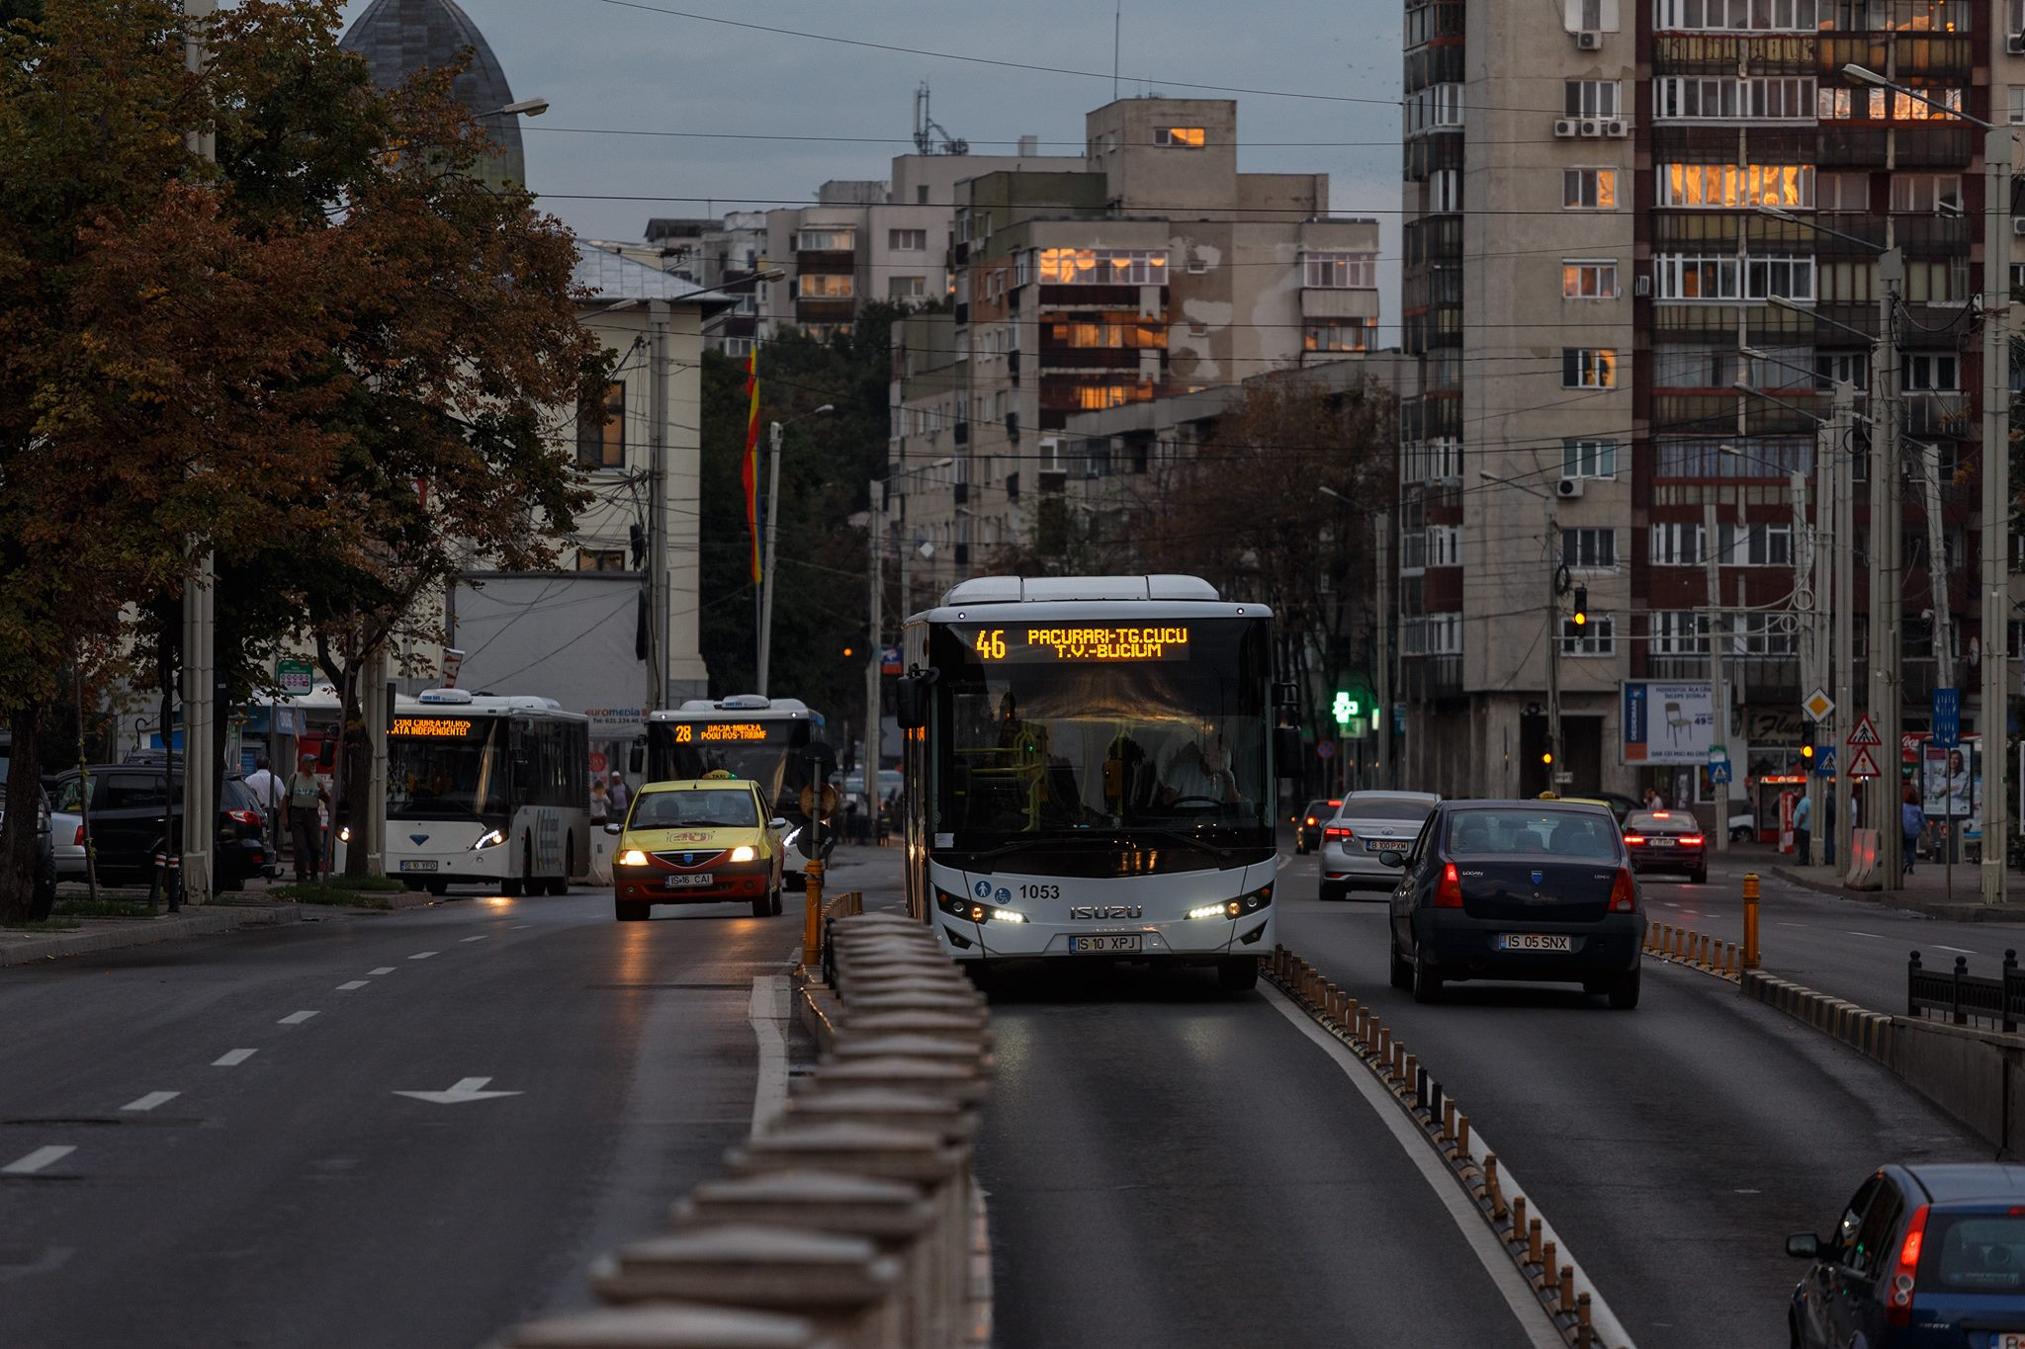
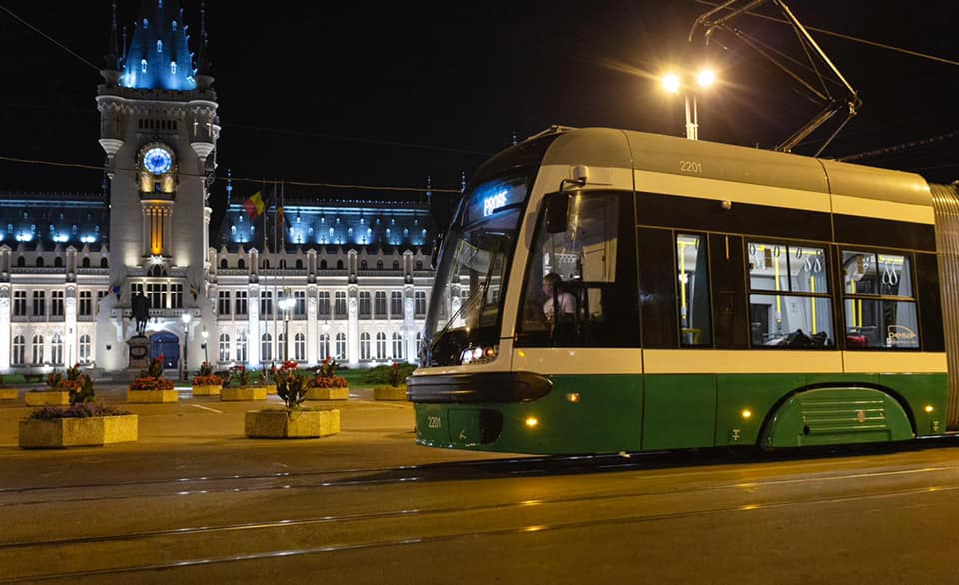
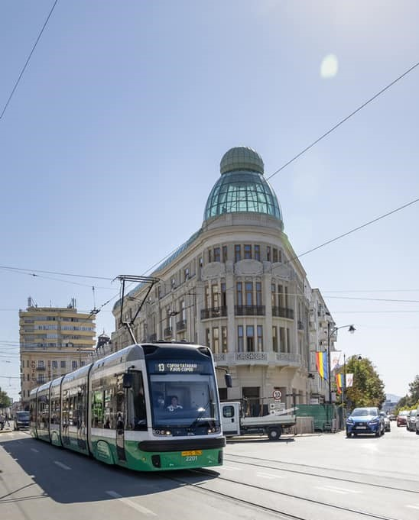
Public transport in Iasi is provided
by busses and trams.

Slide 3
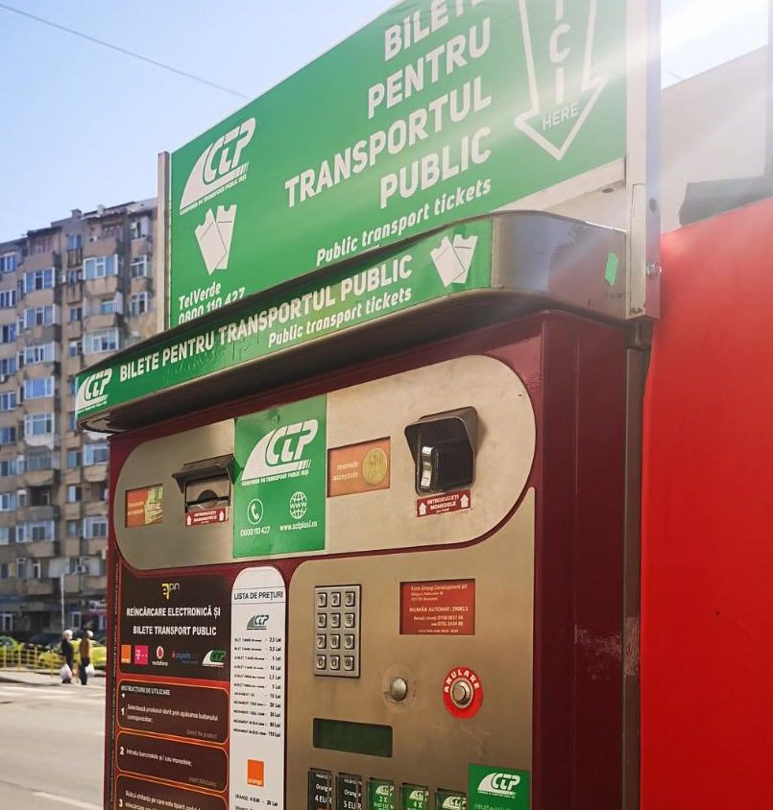
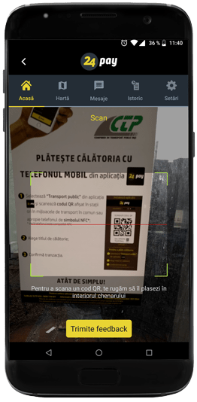
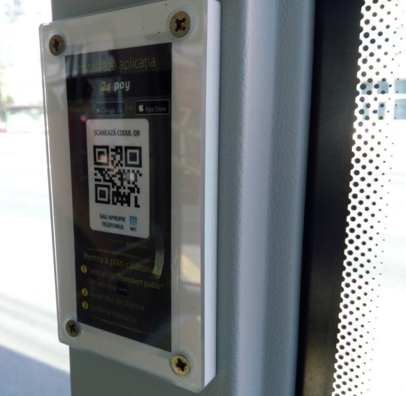
Where/ How to buy tickets ?
2. Phone App – 24 pay (Credit Card)
1. Ticket machines (cash)
Scan the QR code placed in a plastic box from the bus/tram you are in.
A Credit Card must be registered in the app before you can use it.

Slide 4
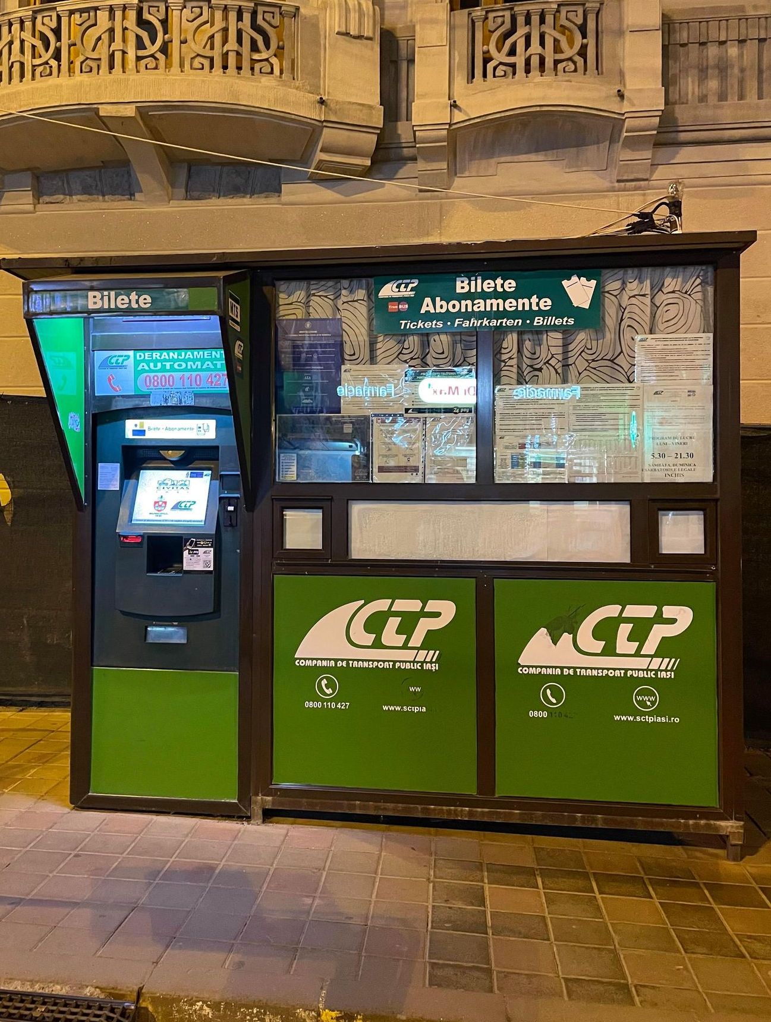
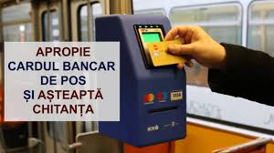
4. Directly in the tram/bus with credit card
3. Ticket stalls (cash)
Working from 6AM-9PM Monday-Friday
Always validate your paper ticket when you enter in the public transport! It is valid for 2 hours for all your journey, even if you change the bus/tram !
Get the card close to the terminal and take the receipt

Slide 5
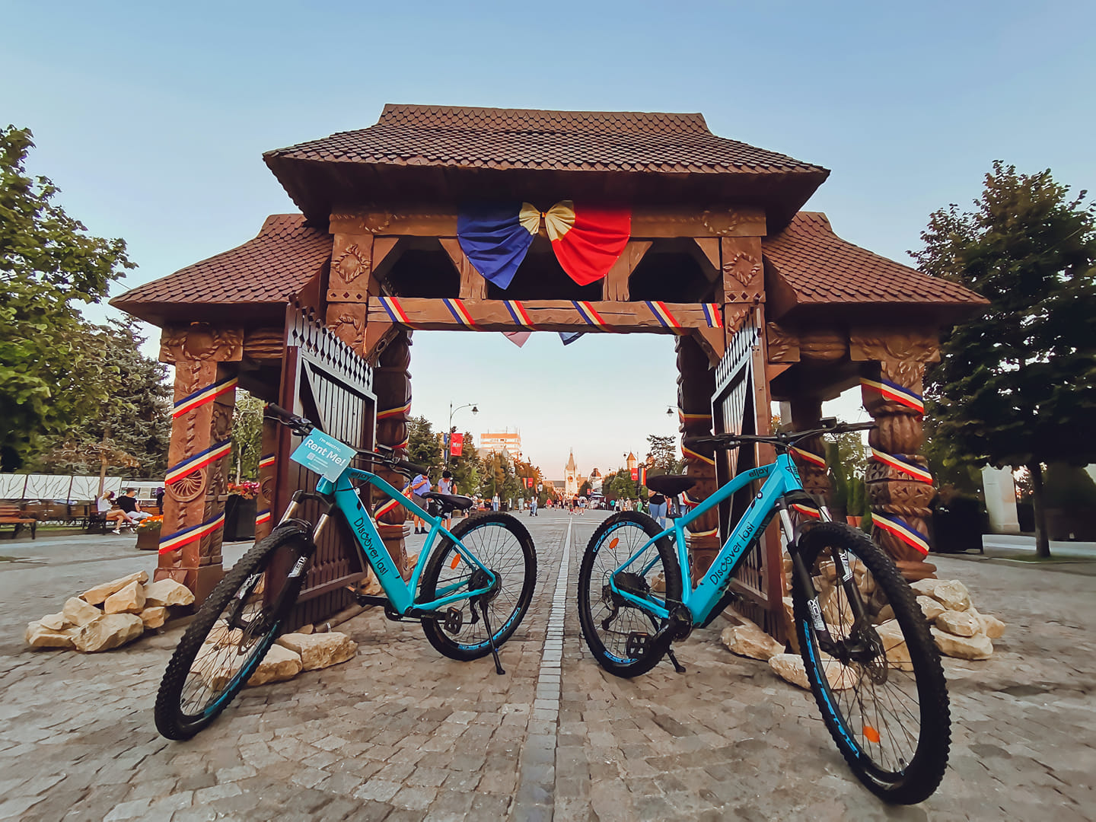
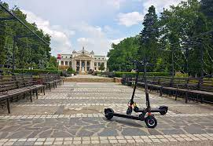
If you do not want to use public transport, there is the option of renting a bicycle or an electric scooter
https://www.facebook.com/discoveriasi
Will be available soon in Iasi

Slide 6
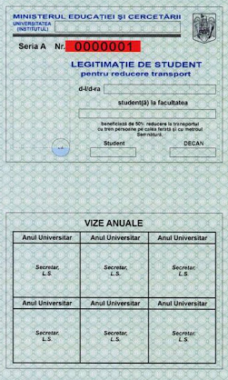
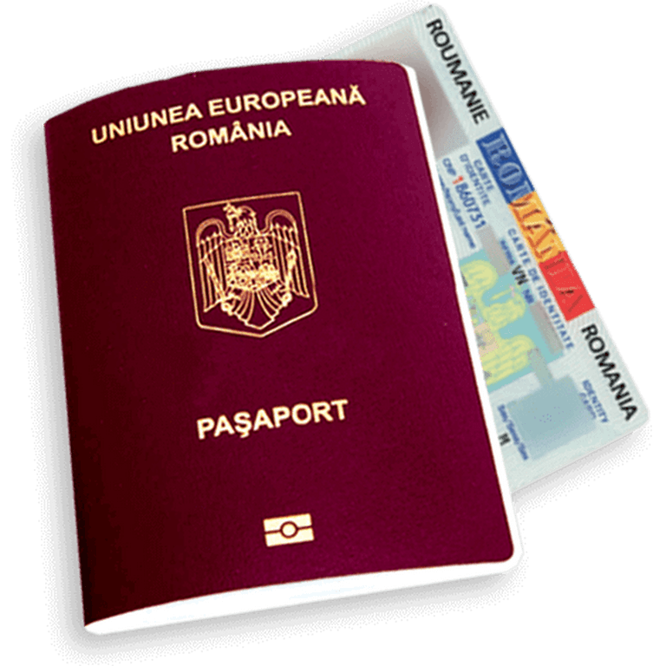
All students from TUIASI receive a travel pass for train for free, valid on all trains categories (Regio and InterRegio), 2nd class.
You can receive the pass as follows:
for Erasmus incoming students: from the International Office;
for International students: from the secretariat office at your faculty.
->If you want to have 50% off
When buying a travel ticket, the student presents:
travel pass stamped for the current academic year
a valid identity card, namely ID card or passport.
When checking the legality of the train journey, the student presents:
a valid travel ticket for that train;
the travel pass;
a valid ID card or passport.
->If you buy a ticket at full price, without the travel pass, it’s enough to show only the travel ticket.
ATTENTION !
If on the train YOU do not present either the travel ticket valid for that train or the documents mentioned above, YOU will be treated in accordance with applicable law.

Slide 7
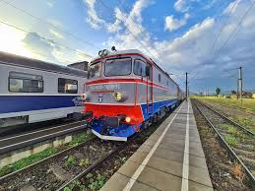
For more information about the trains, additional fees and information please check: https://www.cfrcalatori.ro/en/discounts-pupils-students/

Slide 8
Don’t forget to put on your mask in the public transport and when you travel by train.

